Slide 1


Python Jupyter Notebook Machine Learning
Artificial Intelligence Training Created by Andrew Ferlitsch Instructor July, 2017

Slide 2

Installing Python
Using Python 3
Download Page: https://www.python.org/downloads/
Windows:
Downloaded EXE (installer)
Select RUN (to install)
Choose Next/Continue to all install prompts
Windows Command Prompt
Path to Python interpreter was configured during install.
C:> python --version
Wait until after install is complete.
Windows Command Prompt
Python
Interpreter
Option to display version

Slide 3

Jupyter Notebook
Jupyter.org: Project Jupyter is an open source project was born out of the IPython Project in 2014 as it evolved to support interactive data science and scientific computing across all programming languages.
Interactive Programming Environment
Share Notebooks with others.
Supports 40 Data Science languages (e.g., Python, R, Scala, Julia).
Big Data Integration (e.g., Apache Spark)
Visualization Widgets

Slide 4
Installing Jupyter
Install Instructions: http://jupyter.org/install.html
Less Experienced: Install with Anaconda (installs many packages).
More Experienced: Install with pip3 (command line install)
PIP3
Upgrade to the latest pip3 version.
C:> pip3 install --upgrade pip
Install Jupyter using pip3
C:> pip3 install jupyter

Slide 5
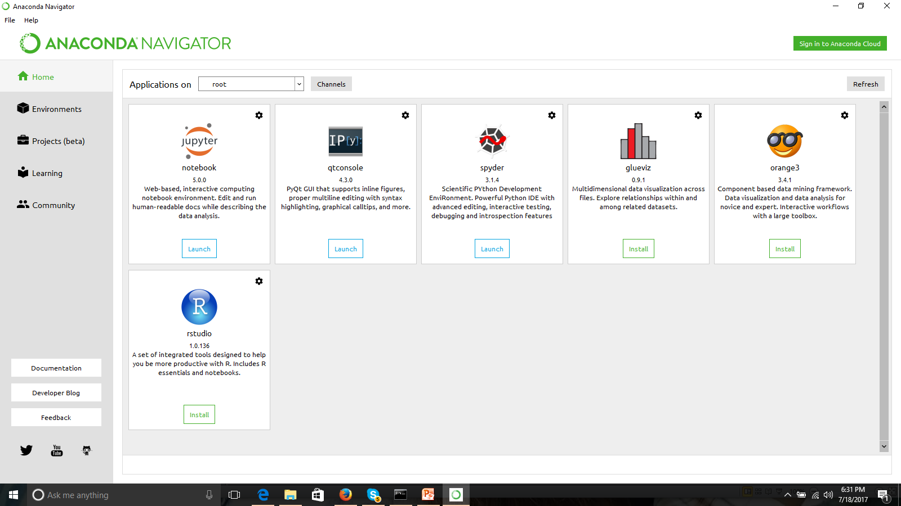
Launching Jupyter from Anaconda
Launch Anaconda and Double Click on Jupyter

Slide 6
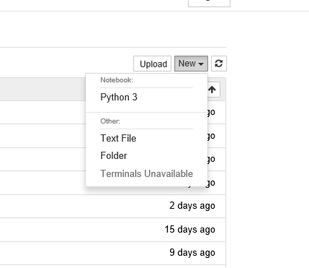
Launching Jupyter from CmdLine
You start the launch of a Jupyter Notebook from the command line.
An instance of the Jupyter Notebook will launch in your web browser as a web application.
C:> jupyter notebook
Upper Right Corner, select New and then Python 3

Slide 7
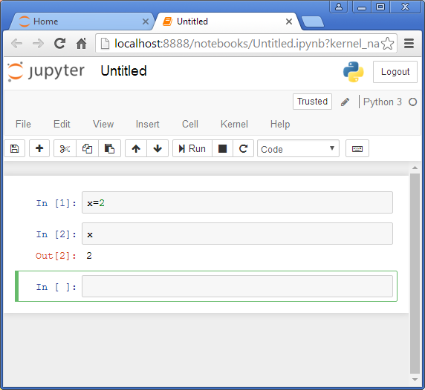
Layout of the Notebook
Run button will execute
An input cell.
Input Cell: You can type
Python code here.
Output Cell: Displays the result
of executing corresponding
Input cell.
Execution state is retained
across cells.
Next (green) unexecuted input cell.

Slide 8
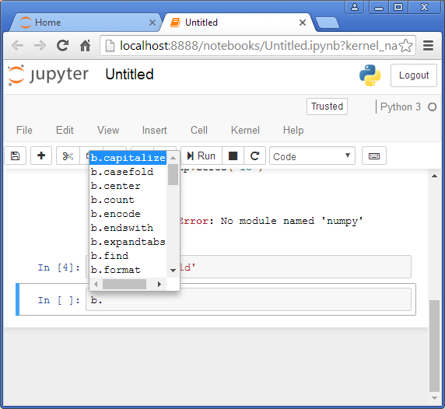
Autocomplete – Methods/Properties
Use the tab key for autocompletion.
Ex. – b is defined as a string.
Select a ‘.’ after b to specify a
method.
Select tab after the ‘.’ and a list of
methods for strings will appear.

Slide 9
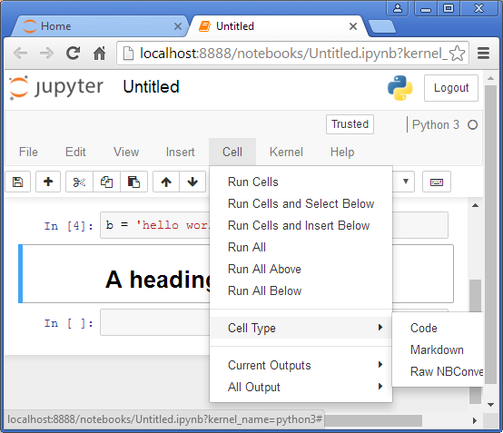
Markdown Cells - Documentation
Text can be added to Jupyter Notebooks using Markdown cells. Markdown is a popular markup language that is a superset of HTML. Its specification can be found here:
https://daringfireball.net/projects/markdown/
Click in a cell and select from the
Menu: Cell -> Cell Type -> Markdown

